Slide 1


Fundamentals of Business Analytics
.
Unit – I
Introduction to Business Analytics
Sai Ram B
Lecturer

Slide 2

Business Analytics

Slide 3






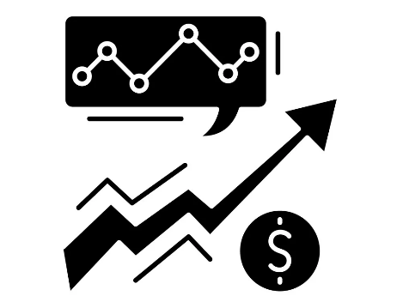
Introduction to Business Analytics
Business Analytics is the process of transforming data into meaningful insights to improve business decisions.

Slide 4


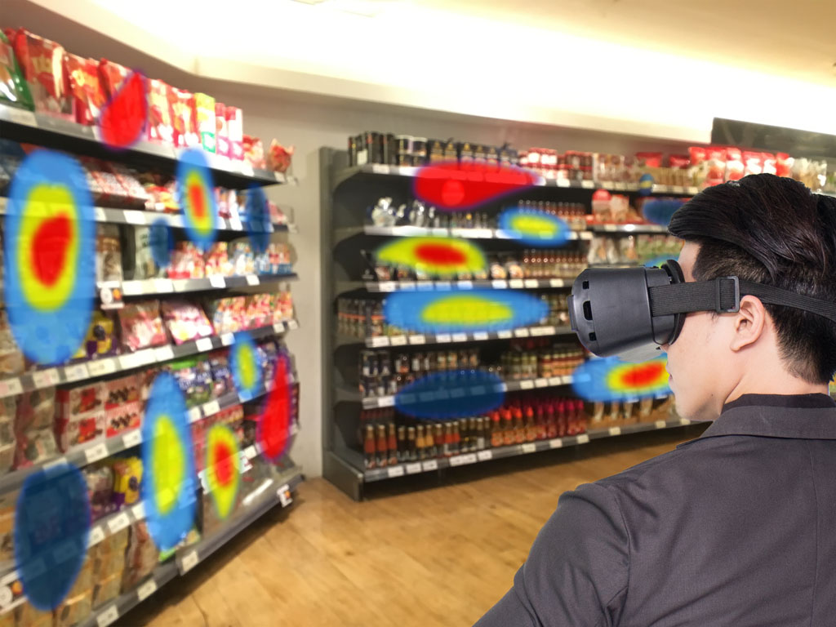
Introduction to Business Analytics
Where we can observe Business Analytics (applications)...!?

Slide 5
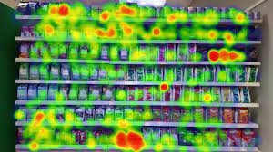
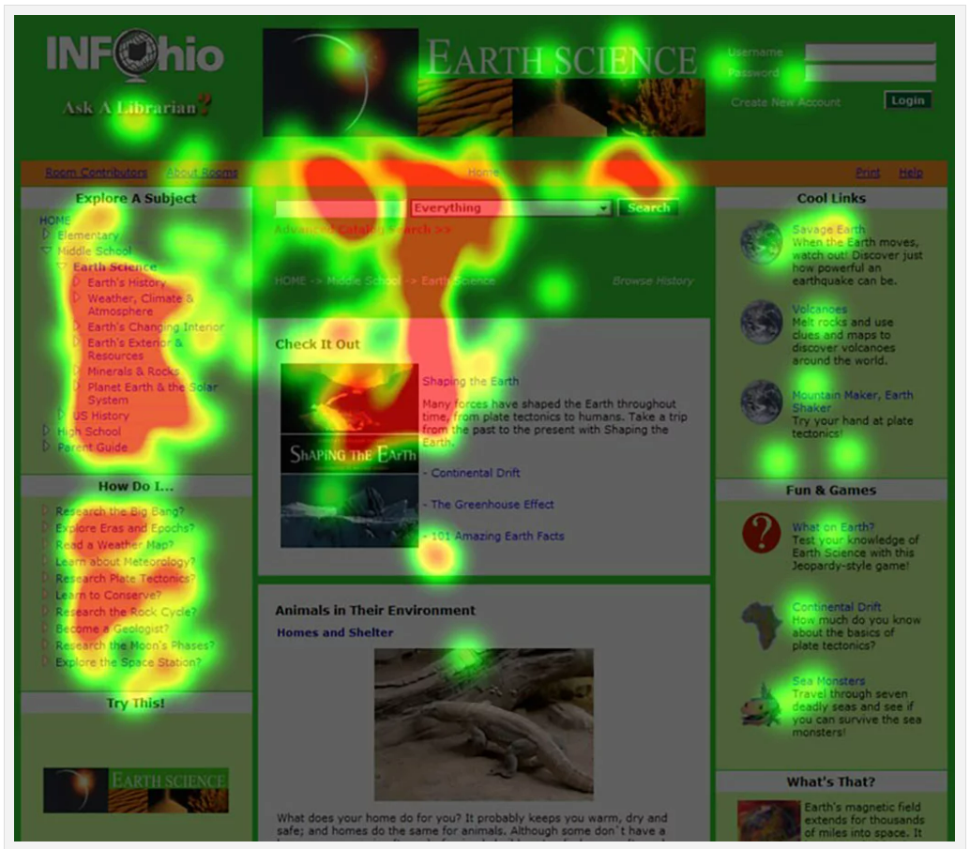
Introduction to Business Analytics

Slide 6
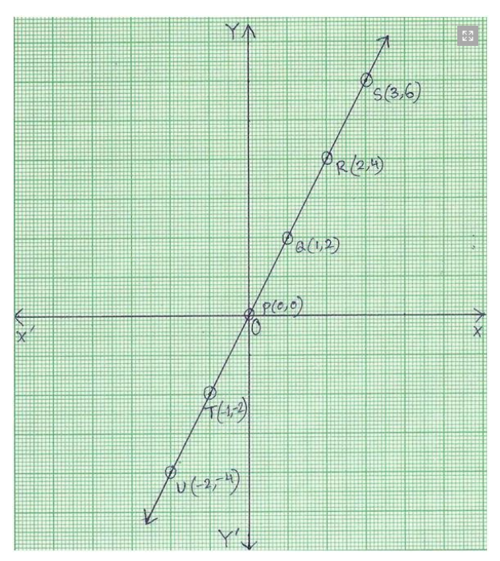
Evolution of Business Analytics
Analytics and visualizations have been utilized for centuries before the involvement of computers and software.

Slide 7
Scope of Business Analytics
The scope of Business Analytics is quite extensive and covers a wide range of activities aimed at using data-driven insights to make informed business decisions and improve overall performance.

Slide 8
Scope of Business Analytics
Business Analytics involves the Collection, Processing, Analysis and Interpretation of data to drive strategic planning, operational improvements and better decision-making across various aspects of an organization.

Slide 9
Scope of Business Analytics
Here are some key areas within the scope of Business Analytics (types of analytics):
Descriptive Analytics
Describes the historical or past data
Predictive Analytics
Predicts the future outcomes using historical data & statistical techniques
Prescriptive Analytics
Takes insights from Descriptive & Predictive Analysis to provide better recommendations

Slide 10
Business Analytics Life Cycle
Data Collection
Data Cleaning & Processing
Data Modelling & Analysis
Identifying the Insights
Designing & Applying the Solution
Identifying Business Problem

Slide 11
Business Analytics Applications
The world has witnessed significant changes and tremendous growth in organizations that have adopted the concepts and principles of business analytics. Business analytics can be applied to a wide range of industries.
Finance
Sales & Marketing
Human Resource Management (HRM)
Customer Relationship Management (CRM)
Production & Inventory Management

Slide 12
Importance of Business Analytics
Business analytics can transform raw data into more valuable inputs to leverage this information in decision making.
To stay competitive, companies need to be ahead of their peers and have all the latest toolsets to assist their decision making in improving efficiency as well as generating more profits.

Slide 13
Scales of Measurement
Scale is a device or an object used to measure or quantify any event or another object.
In Statistics, the variables or numbers are defined and categorized using different scales of measurements. Each level of measurement scale has specific properties that determine the various use of statistical analysis.

Slide 14
Scales of Measurement
There are four different scales of measurement. The data can be defined as being one of the four scales. The four types of scales are:
i. Nominal Scale
Qualitative Data
ii. Ordinal Scale
iii. Interval Scale
Quantitative Data
iv. Ratio Scale

Slide 15
Scales of Measurement
i. Nominal Scale
Variables are categorized into distinct categories or groups with no inherent order or ranking.
Eg: Name, Gender, Roll No. etc.
ii. Ordinal Scale
Variables can be measured into categories with a meaningful order or ranking but the differences between the categories are not consistent or measurable.
Eg: Student Rank, Satisfaction Levels (Low, Medium, High) etc.
iii. Interval Scale
Variables measured into categories with a meaningful order, and the differences between categories are consistent and measurable. However, there is no true zero point. Eg: Temperature on the Celsius or Fahrenheit scales and IQ scores
iv. Ratio Scale
Variables have all the characteristics of an interval scale, along with a true zero point, which allows for meaningful ratios of values.
Eg: Height, Weight, Income and Age.

Slide 16
Inferential Analysis
Inferential Analysis is used to draw and measure the reliability of conclusions about a population that is based on information gathered from a sample of the population. Since inferential analysis doesn’t sample everyone in a population, the results will always contain some level of uncertainty.

Slide 17
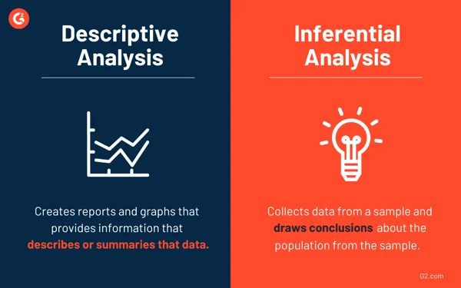
Inferential Analysis
Inferential Analysis Vs. Descriptive Analysis

Slide 18
Inferential Analysis (use pic links)
Types of Inferential Analysis
Correlation Analysis (-1 to +1)
Used to understand the extent to which two variables are dependent on one another. This analysis essentially tests the strength of the relationship between two variables and if their correlation is strong or weak.
Linear Regression Analysis
Used to model the relationship between a dependent variable (also called the target or outcome) and one or more independent variables (also known as predictors or features).

Slide 19
Inferential Analysis
Advantages of Inferential Analysis
This information provides researchers and analysts with comprehensive insights into relationships between two variables. It can also show awareness towards cause and effect and predictions regarding trends and patterns throughout industries.
Plus, since it is so widely used in the business world as well as academia, it’s a universally accepted method of statistical analysis.

Slide 20
Inferential Analysis
Limitations of Inferential Analysis
> As inferential analysis is based on the process of using values measured in a sample to conclude the values that would be measured from the total population, there will always be some level of uncertainty regarding the results and it can’t be 100% sure that the statistics being calculated are correct.
> Some inferential tests require the analyst or researcher to make an educated guess based on theories to run the tests. Similar to the first limitation, there will be uncertainty surrounding these guesses, which will also mean some repercussions on the reliability of the results of some statistical tests.

Slide 21
Decision Analysis
Decision analysis is a systematic and quantitative approach to make decisions in situations involving uncertainty and multiple alternatives. It combines elements of mathematics, statistics, economics, and decision theory to provide a structured framework for evaluating and selecting the best course of action among various choices.
The main goal of decision analysis is to help individuals and organizations make informed decisions that are based on rationality and a thorough consideration of the available information and potential outcomes.

Slide 22
Decision Analysis
Example: If a real estate development company is deciding on whether or not to build a new shopping center in a location, they might examine several pieces of input to aid in their decision-making process. These might include traffic at the proposed location on various days of the week at different times, the popularity of similar shopping centers in the area, financial demographics, local competition and preferred shopping habits of the area population. All of these items can be put into a decision-analysis program and different simulations are run that help the company make a decision about the shopping center.

Slide 23
Big Data Analytics
Big data is a high volume, high velocity, high variety information asset that demands cost-effective and innovative forms of information processing for enhanced business insight and decision making.
Hence, big data involves homogeneous voluminous data that could be structured (as in RDBMS) or unstructured (as in blogs, tweets, Facebook comments, emails) and the content is in different varieties (audio, picture, large text). Handling this type of data will need newer and innovative technologies for capturing, storing, searching, integrating, analyzing and presenting newly found insights.

Slide 24
Big Data Analytics
Characteristics of Big Data
Volume: Volume is obviously the most common trait of Big Data. Many factors contributed to the exponential increase in data volume.
Eg: Transaction-based data stored through the years, text data constantly streaming in from social media etc.
The highest mass of data that used to be called petabytes (PB = 10,00,000 GB) has left its place to zeta bytes (ZB = 1,00,000 GB), which is a terabytes (TB = 1,000 GB).
(1 TB can hold 200,000 songs or 17,000 hours of music / 500 hours of movies)

Slide 25
Big Data Analytics
2) Variety: These days data comes in all types of formats ranging from traditional databases to hierarchical data stores created by the end users to text documents, e-mail, XML, meter-collected and sensor-captured data, to video, audio and stock ticker data.
By some estimates, 80 to 85% of all organizations’ data is in some sort of unstructured or semi - structured format (a format that is not suitable for traditional databases schemas). But there is no denying its value, and, hence, it must be included in the analyses to support decision making.

Slide 26
Big Data Analytics
3) Velocity: In simple words, velocity means the speed of something in a given direction.
According to Gartner, velocity means both how fast data is being produced and how fast the data must be processed (i.e., captured, stored, and analyzed) to meet the need or demand. Velocity is perhaps the most overlooked characteristic of Big Data. Reacting quickly enough to deal with velocity is a challenge to most organizations.

Slide 27
Big Data Analytics
4) Veracity: Veracity is a term coined by IBM. It refers to conformity to facts: accuracy, quality, truthfulness, or trustworthiness of the data. Tools and techniques are often used to handle Big Data’s veracity by transforming the data into quality and trustworthy insights.
5) Variability: In addition to the increasing velocities and varieties of data, data flows can be highly inconsistent with periodic peaks. Daily, seasonal, and event-triggered peak data loads can be challenging to manage-especially with social media involved.

Slide 28
Big Data Analytics
Challenges for adopting Big Data analytics
Data Volume
Data Integration
Processing Capabilities
Data Governance
Skills Availability
Solution Cost

Slide 29
Big Data Analytics
Benefits of Big Data Analytics
Understanding and Target Customers
Understanding and Optimizing Business Process
Re-developing the existing products
Personal Quantification and Performance Optimization
Helps in Fraud Detection & improving Security
To Perform Risk Analysis
Customize your website in real time
Optimizing Machine and Device Performance

Slide 30
Thank You…

